Slide 1


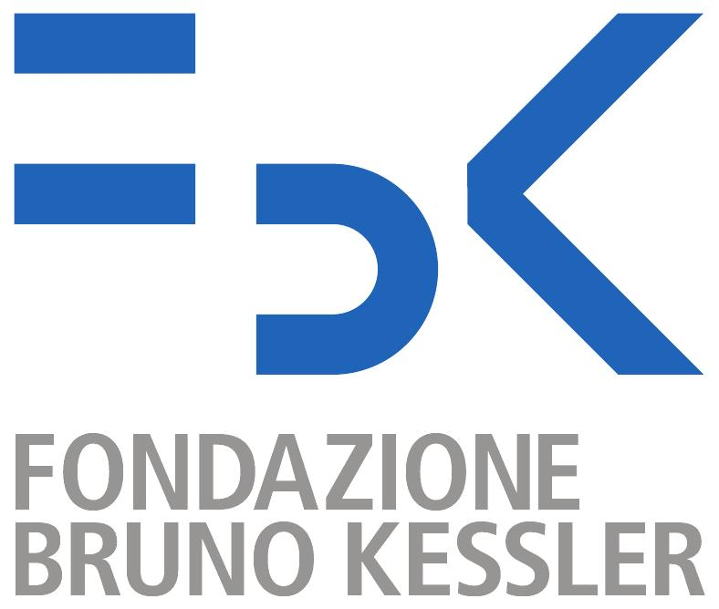
Basic security mechanisms
Silvio Ranise – Head of the Security & Trust Research Unit
ranise@fbk.eu / http://st.fbk.eu/SilvioRanise
Notes:
http://www.beechamresearch.com/article.aspx?id=4

Slide 2
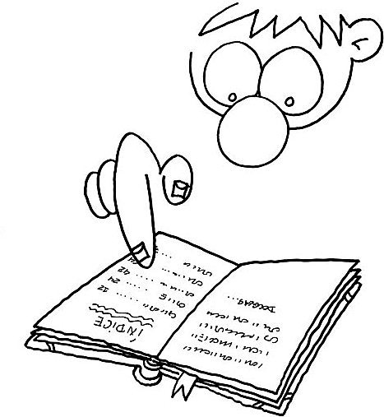
contents
“The” example of IoT-based attack
Mirai botnet
Basic security mechanisms
Authentication
Access Control
Recap questions and exercises

Slide 3

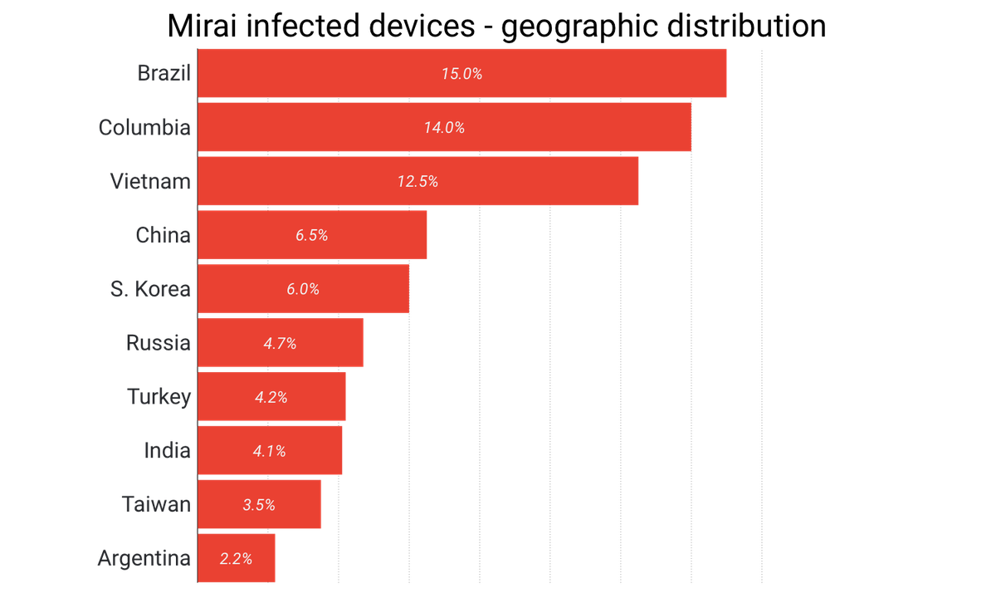
mirai
600 Gbps!
Reasons of Mirai’s effectiveness
Spreading based on Internet-wide scanning
Use of insecure default passwords in IoT products
MIRAI was able to infect over 600,000 IoT devices by simply exploiting a set of 61 well-known default IoT login/password combinations
Simple botnet allows to infect heterogeneous devices
Impact of attacks
Krebs on security: “The Democratization of Censorship”
DYN (DNS provider): impossible to access popular web sites such as Amazon, Twitter, Paypal, …
Lonestar (telco): shutting down Internet for an entire country (Liberia)

Slide 4

Analysis of mirai
IoT devices security has been neglected
No more default-open ports, rather default-closed ports
Adopt default networking configurations limiting remote address access to those devices to local networks or specific providers
Principle of least privilege, set isolation boundaries
Adoption of automatic updates
Timely mechanism to patch bugs and vulnerabilities without burdening consumers with maintenance tasks or requiring a recall
Challenge: cryptographic primitives for resource-constrained devices to build PKI infrastructure for supporting trusted updates
Incentives for the security community
E.g., bug bounty programs

Slide 5
Authentication

Slide 6
Authn
Authentication = process of verifying a user’s identity
Two reasons for authenticating a user:
The user identity is a parameter in access control decisions
The user identity is recorded when logging security relevant events in an audit trail
It is not always necessary or desirable to base access control on user identities
Much stronger case for using identities in audit logs (auditability)

Slide 7
User authN
When logging on to a computer you enter
user name and
password
Entering user name:
You announce who you are
Entering password:
You prove that you are who you claim to be
Authentication by password is widely accepted and not too difficult to implement

Slide 8
AUTHN: bootstrapping
Passwords should be secrets shared between the user and the system
How do you bootstrap a system so that the password ends up in the right places, but nowhere else?
In an enterprise, users can collect their password personally
Otherwise, the password could be sent by mail, email, or phone, or entered by the user on a web page
Who might intercept the message and who might actually pick it up?
Ex: a letter containing the password for an online bank account might be stolen or an impersonator may phone in asking for another user’s password.

Slide 9
Guessing Passwords
Brute force (exhaustive search): try all possible combinations of valid symbols up to a certain length
Being smarter: search through a restricted name space
Ex: passwords associated with a user like name, names of friends and relatives, car brand, car registration number, phone number,…, or try popular passwords popular.
Typical example: dictionary attack, i.e. trying all passwords from an on-line dictionary
You cannot prevent an attacker from accidentally guessing a valid password, but you can try to reduce the probability of a password compromise

Slide 10
Mitigations
Change default passwords!
Often passwords for system accounts have a default value (e.g., admin)
Avoid guessable passwords:
Prescribe a minimal password length
Password format: mix upper and lower case, include numerical and other non-alphabetical symbols
Today on-line dictionaries for almost every language exist

Slide 11
Mitigations
Obvious?
Change default passwords!
Often passwords for system accounts have a default value (e.g., admin)
Avoid guessable passwords:
Prescribe a minimal password length
Password format: mix upper and lower case, include numerical and other non-alphabetical symbols
Today on-line dictionaries for almost every language exist

Slide 12
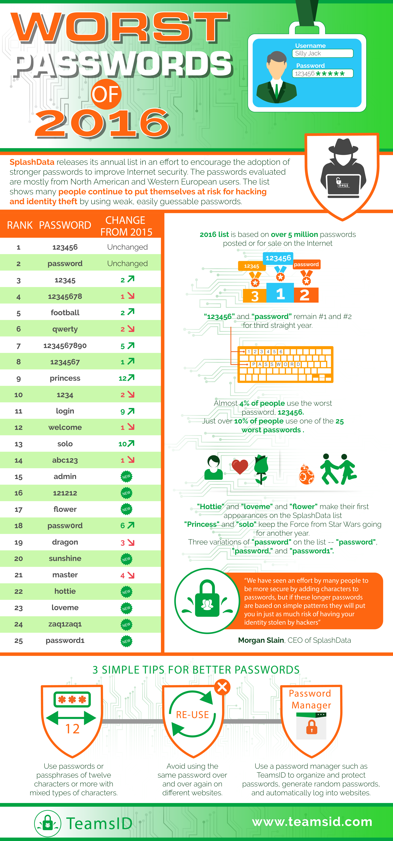
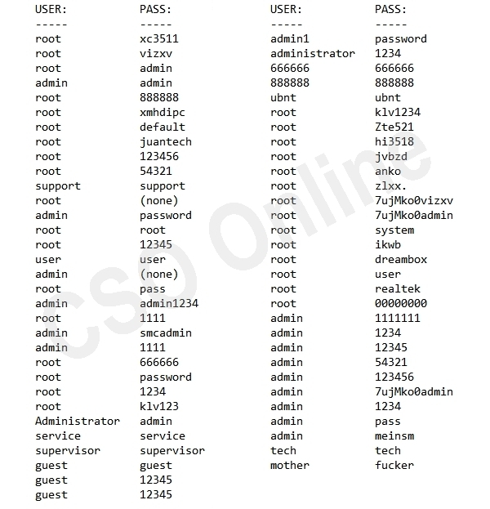
First version of Mirai used the following 61 combinations of username and password!

Slide 13
Mitigations
Not so obvious!
Change default passwords!
Often passwords for system accounts have a default value (e.g., admin)
Avoid guessable passwords:
Prescribe a minimal password length
Password format: mix upper and lower case, include numerical and other non-alphabetical symbols
Today on-line dictionaries for almost every language exist

Slide 14
Mitigations
Change default passwords!
Often passwords for system accounts have a default value (e.g., admin)
Avoid guessable passwords:
Prescribe a minimal password length
Password format: mix upper and lower case, include numerical and other non-alphabetical symbols
Today on-line dictionaries for almost every language exist
Effective?

Slide 16
Mitigations
Change default passwords!
Often passwords for system accounts have a default value (e.g., admin)
Avoid guessable passwords:
Prescribe a minimal password length
Password format: mix upper and lower case, include numerical and other non-alphabetical symbols
Today on-line dictionaries for almost every language exist
Not really!!!

Slide 17
technical mitigations
Operating system maintains a file with user names and passwords
Attacker could try to compromise the confidentiality / integrity of password file
Options for protecting the password file:
cryptographic protection
access control enforced by the operating system
combination of cryptographic protection and access control, possibly with further measures to slow down dictionary attacks

Slide 18
Cryptographic hash
Cryptographic hash function = a 1-way function f is a function that is relatively easy to compute but hard to reverse, i.e.
Given an input x it is easy to compute f(x), but given an output y it is hard to find x so that y = f(x)
Instead of the password x, the value f(x) is stored in the password file; when a user logs in entering a password x’, the system applies the one-way function f and compares f(x’) with the expected value f(x)

Slide 19
Cryptographic hash
Cryptographic hash function = a 1-way function f is a function that is relatively easy to compute but hard to reverse, i.e.
Given an input x it is easy to compute f(x), but given an output y it is hard to find x so that y = f(x)
Instead of the password x, the value f(x) is stored in the password file; when a user logs in entering a password x’, the system applies the one-way function f and compares f(x’) with the expected value f(x)
Brute force attacks are no more possible?

Slide 20
SALTING
To slow down dictionary attacks, a salt is appended to the password before encryption and stored with the encrypted password
If two users have the same password, they will now have different entries in the file of encrypted passwords
Ex: Unix uses a 12 bit salt.

Slide 21
Exercise on cryptographic hashing
Hashing
>>> import hashlib
>>> str = your favorite string
>>> hash = hashlib.sha256(str.encode(‘utf-8’))
>>> hash.hexdigest()
Try to change just a single character of your favorite string and see if the resulting hash differs from the previous one
Do you think this is an important property of hash functions?
Think of guessing passwords and proceed to the next exercise
Have a look at the documentation about hashlib

Slide 22
Exercise on salting
Salting
>>> import hashlib, uuid
>>> salt = str(uuid.uuid4().hex)
>>> salted_hash = hashlib.sha512((str + salt).encode(‘utf-8’))
>>> salted_hash.hexdigest()
Why in previous exercise we use sha256 while here we use sha512?
Understand what the uuid4 function does by having a look at the documentation of the uuid library
Do you think that now we are better protected against password guessing?

Slide 23
Non technical mitigations
Words of wisdom

Slide 24
Access control
Not all authenticated users are created equal!

Slide 25
ACCESS CONTROL: an example
Only privileged users must have write access to the password file
Otherwise, an attacker could get access to the data of other users simply by changing their password, even if it is protected by cryptographic means
If read access is restricted to privileged users, then passwords in theory could be stored unencrypted
If password file contains data required by unprivileged users, passwords must be “encrypted”; such a file can still be used in dictionary attacks
Ex: /etc/passwd file in Unix; many versions of Unix thus store encrypted passwords in a shadow password file that is not publicly accessible.

Slide 26
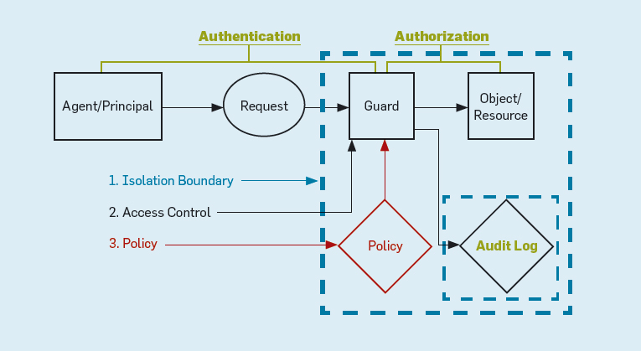
ACCESS CONTROL

Slide 27
AC definition
The process of
mediating requests to resources and data of a system and
determining whether a request should be granted or denied
Flow: user u wants to perform action a on resource r
Access request (u,a,r) is sent to access control module
The access control module returns grant/deny
If answer = grant, then system allows u to perform a on r. Else u is informed that cannot perform a on r

Slide 28
The basic model: ac matrix
The meaning of policies of the form “a subject can perform some actions on an object” can be given in terms of the Access Control Matrix (ACM)
Given all subjects and objects, the ACM enumerates what actions are allowed for each subject/object pair

Slide 29
enforcement mechanisms for AC matrix

Slide 30
Recap questions
What is a DDoS?
What is a botnet?
What is authentication?
What is access control?
What are their relationships?

